Slide 1
Advanced Data Structures for AI
Week 4 – Graphs: Representations, Traversal and Topological Sorting

Slide 2
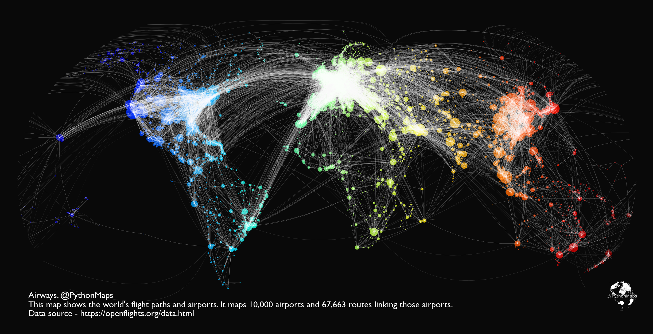
Graphs: Introduction

Slide 3
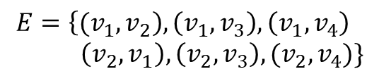






Graphs: Introduction
Concept
Binary relation over a finite set
$$v_{1}$$
$$v_{2}$$
$$V=\{v_{1}, v_{2}, v_{3},v_{4}\}$$
Types of graphs:
Directed
Undirected
$$E=\left\{{(v}_{1}, v_{2}\right),\left(v_{1},v_{3}\right),\left(v_{1},v_{4}\right) \\ \left(v_{2},v_{1}\right),\left(v_{2},v_{3}\right),(v_{2},v_{4})\}$$
$$v_{3}$$
$$v_{4}$$
Symmetric relation
nodes/vertices
Directionless or bidirectional
Some situations that are not considered:
Self-loops: loops over a vertex
Multi-edges

$$v$$



Slide 4

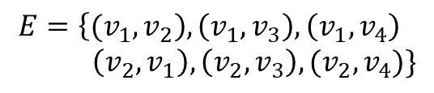
Graphs: Introduction
Where do graphs come from?
Computer Networks
Social networks
Ecological networks
Electrical circuits
Programs
Google maps
Traversal
Identify cycles
Ranking nodes
Shortest paths
Finding spanning trees
Graph flows
$$V=\{v_{1}, v_{2}, v_{3},v_{4}\}$$
server,
people,
animals,
junctions,
data,
address
$$E=\left\{{(v}_{1}, v_{2}\right),\left(v_{1},v_{3}\right),\left(v_{1},v_{4}\right) \\ \left(v_{2},v_{1}\right),\left(v_{2},v_{3}\right),(v_{2},v_{4})\}$$
links,
relation,
Prey/predator,
wires,
dependencies,
road

Slide 5



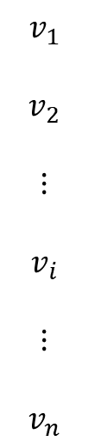


Graphs: Representation
How do we represent graphs on the computer?
Adjacency matrix $→$ is there an edge $\left(n_{i}, n_{j}\right)∈E$
$$v_{1} v_{2} ⋯ { v}_{j} ⋯ v_{n}$$
Revisit the real-world graphs:
Computer Networks
Social networks
Ecological networks
Electrical circuits
Programs
Google maps
$$v_{1}$$
$$v_{2}$$
$$⋮$$
$$v_{i}$$
$$⋮$$
$$v_{n}$$
$$1$$
$$edge from v_{2} to v_{1}$$
$$1$$
$$edge from v_{i} to v_{j}$$
Sparsity

Slide 6



Graphs: Representation
Adjacency List
A graph of n vertices and m edges, the size of adjacency list will be n+m or |V|+|E|
$$v_{1}$$
$$v_{2}$$
n cells
neighbours/adjacent nodes
$$v_{n}$$

Slide 7
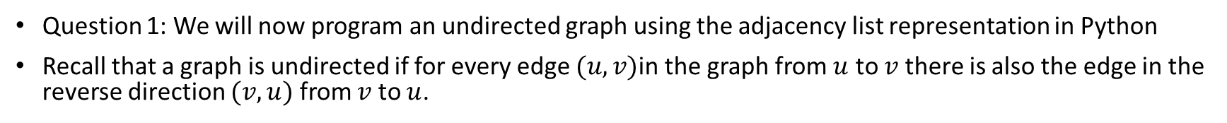
Graphs: Representation
Question 1: We will now program an undirected graph using the adjacency list representation in Python
Recall that a graph is undirected if for every edge $(u,v)$in the graph from $u$ to $v$ there is also the edge in the reverse direction $(v,u)$ from $v$ to $u$.
class UndirectedGraph:
#n is the number of vertices
#we will label the vertices from 0 to self.n-1
#Initialize to an empty adjacency list
#we will store the outgoing edges using a set data structure
def __init__(self, n):
self.n = n
self.adj_list = [set() for i in range(self.n)]
def add_edge(self, i, j):
assert 0<=i<self.n
assert 0<=j<self.n
assert i!=j
#make sure to add edge from i to j
#your code here
#also add edge from j to i
#your code here
#get a set of all vertices that are neighbours of the vertex i
def get_neighbouring_vertices(self, i):
#your code here
#Test your code
#create the graph for G
g = UndirectedGraph(5)
g.add_edge(0,1)
g.add_edge(0,2)
g.add_edge(0,4)
g.add_edge(2,3)
g.add_edge(2,4)
g.add_edge(3,4)
1
2
3
0
4
Additional resources: python set

Slide 8
Graphs: Traversal
Graph traversal – visit nodes in a graph in some order
Can only visit a node at most once
If visit a new node, it must be along an edge starting from an already visited node
2
3
8
1
start
4
5
9
6
7

Slide 9
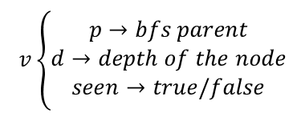
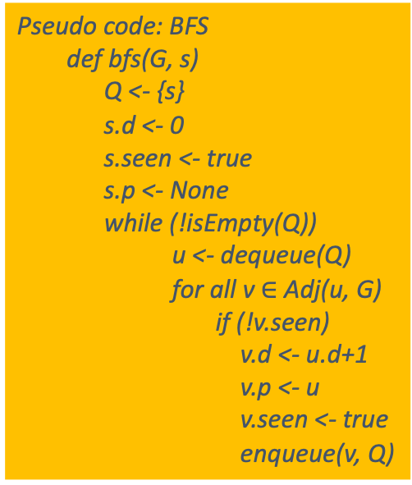
Graphs: Traversal
BFS: shortest path algorithm
Breadth first search (BFS)
2
Pseudo code: BFS
def bfs(G, s)
Q <- {s}
s.d <- 0
s.seen <- true
s.p <- None
while (!isEmpty(Q))
u <- dequeue(Q)
for all v $∈$ Adj(u, G)
if (!v.seen)
v.d <- u.d+1
v.p <- u
v.seen <- true
enqueue(v, Q)
3
Queue Data Structure
Maintain some attributes for
each node in the graph
1
start
4
5
6
$$v\left\{\begin{aligned}p→bfs parent \\ d→depth of the node \\ seen→true/false\end{aligned}\right.$$
7
FIFO
Queue
1
2
4
3
6
5
7
e.g.
0.p = None, 0.d = 0, 0.seen = true
3.p = 2, 3.d = 2, 3.seen = false
2
3
5
1
start
4
6
7

Slide 10

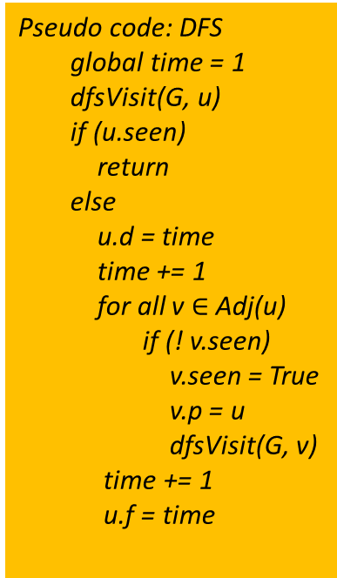
Graphs: Traversal
$$v\left\{\begin{aligned}p→bfs parent \\ d→discovery time \\ f→finish time \\ seen→true/false\end{aligned}\right.$$
Depth First Search (DFS)
Pseudo code: DFS
global time = 1
dfsVisit(G, u)
if (u.seen)
return
else
u.d = time
time += 1
for all v $∈$ Adj(u)
if (! v.seen)
v.seen = True
v.p = u
dfsVisit(G, v)
time += 1
u.f = time
dfsVisit
3
1
visit(1)
5
6
2
6
1
visit(2)
visit(3)
4
3
2
visit(4)
4
visit(5)
5
visit(6)

Slide 11
Graphs: Traversal
Depth First Search (DFS): DFS tree
1
3
2
3
5
forward edge
6
1
4
cross edge
4
2
back-edge
5
6

Slide 12
Graphs: Traversal
outer loop:
for i = 1 to n
dfsVisit(G, i)
Types of edges:
1
5
1. Tree edges: (1,4), (5,6)
6
7
2. Back edges: (3,1), (8,7)
 | p | d | f | seen
 | NIL | 1 | 10 | T
 | NIL | 11 | 12 | T
● | ❍ | 3 | 4 | T
❍ |  | 2 | 9 | T
■ | ❍ | 5 | 8 | T
□ | ■ | 6 | 7 | T
❐ | NIL | 13 | 16 | T
❑ | ❐ | 14 | 15 | T
3. Forward edges: (4,6)
2
4
8
4. Cross edges: (2,1), (2,3)
3
Categorize edges:
DFS Forest
u
Forward edges:
u.d < v.d < v.f < u.f
2
1
Back edges:
v.d < u.d < u.f < v.f
7
Cross edges: (u.d, u.f)
and (v.d, v.f) are disjoint
3
4
5
6
v
8
A directed graph is cyclic when DFS gives back edges

Slide 13
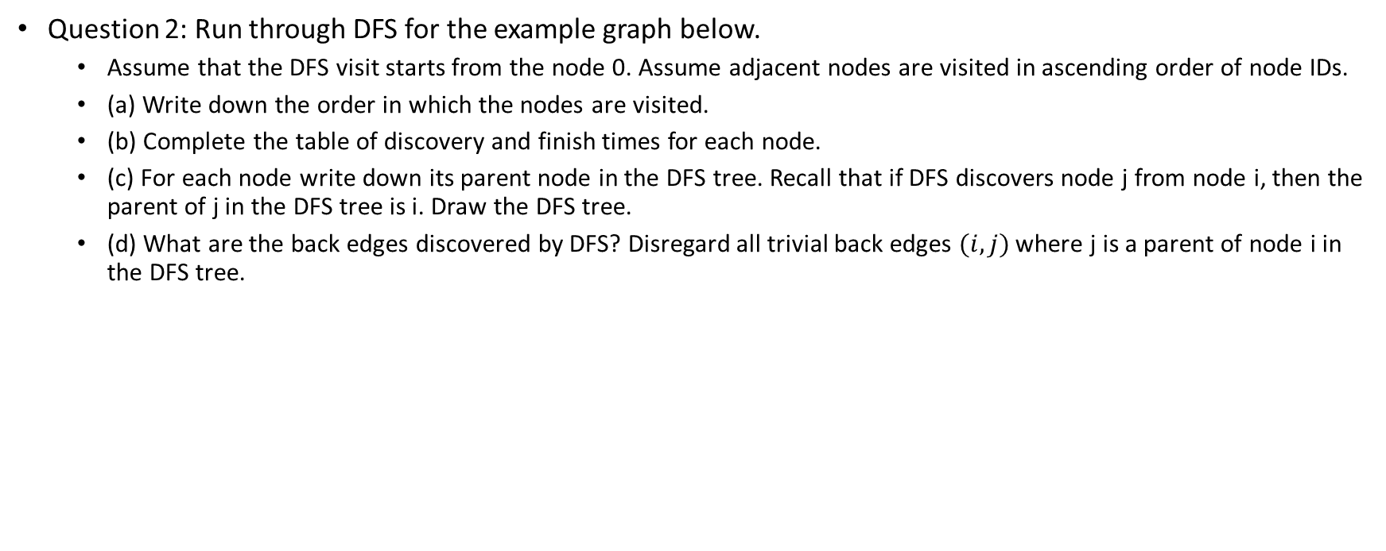
Graphs: Traversal
Question 2: Run through DFS for the example graph below.
Assume that the DFS visit starts from the node 0. Assume adjacent nodes are visited in ascending order of node IDs.
(a) Write down the order in which the nodes are visited.
(b) Complete the table of discovery and finish times for each node.
(c) For each node write down its parent node in the DFS tree. Recall that if DFS discovers node j from node i, then the parent of j in the DFS tree is i. Draw the DFS tree.
(d) What are the back edges discovered by DFS? Disregard all trivial back edges $(i, j)$ where j is a parent of node i in the DFS tree.
1
2
3
0
4

Slide 14
Graphs: Traversal
Question 3: Complete the code for the dfs_visit function below.
To do so, please read the rest of the code provided and the surrounding comments very carefully
Please ensure that the following rules are followed:
When visiting a node i, consider the set of adjacent nodes in increasing order. This is automatically done by using self.adj_list[i].
Use the DFSTimeCounter class provided to keep track of DFS time.
The timer should be incremented just before we return from dfs_visit and record the finish time for a node.
Recall that a back edge in a DFS is encountered whenever we visit a node i and encounter adjacent node j such that j has been discovered but not finished. If this happens, add(i,j) to the set of back edges.
The dfs_visit code does not return anything but updates the arguments discovery_times, finish_times, dfs_tree_parent and dfs_back_edges in place.
Please see Moodle page for code snippet: Week 4 – In class programming question
Please see Moodle page for test code: Week 4 – In class programming test code

Slide 15
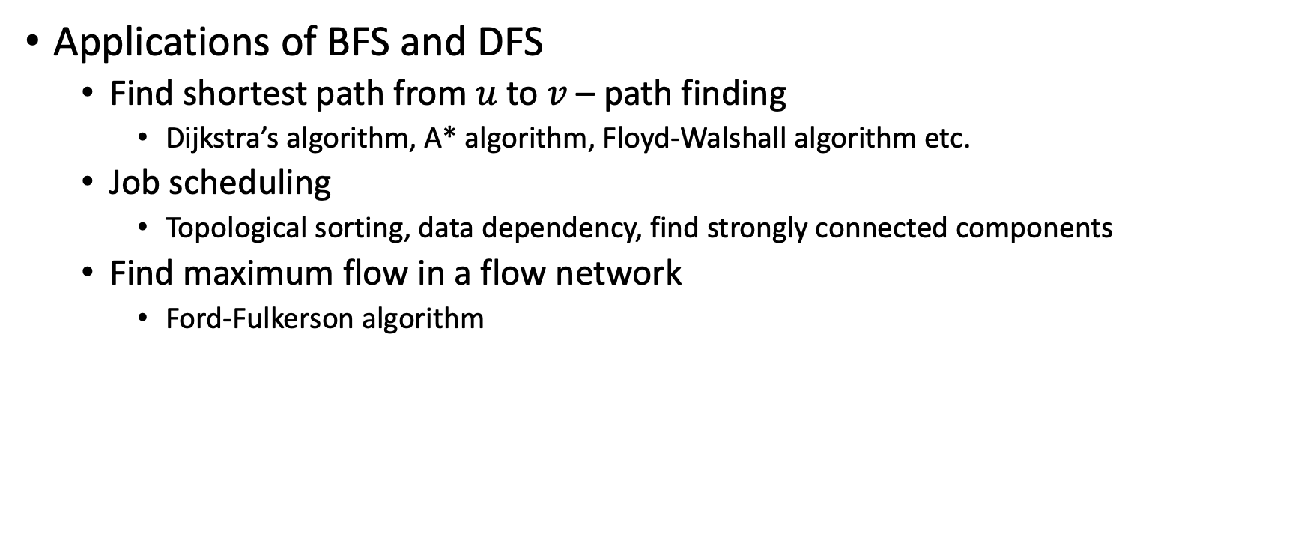
Graphs: Traversal
Applications of BFS and DFS
Find shortest path from $u$ to $v$ – path finding
Dijkstra’s algorithm, A* algorithm, Floyd-Walshall algorithm etc.
Job scheduling
Topological sorting, data dependency, find strongly connected components
Find maximum flow in a flow network
Ford-Fulkerson algorithm
Notes:
Applications of BFS and DFS

Slide 16
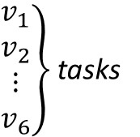












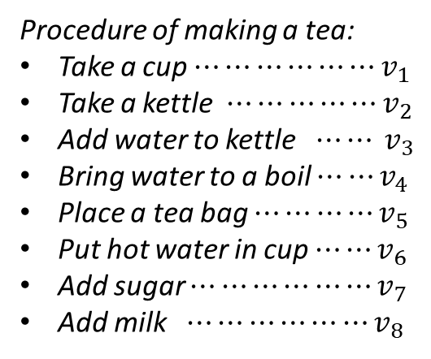

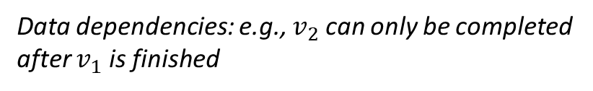

Graphs: Topological Sort
Data dependencies: e.g., $v_{2}$ can only be completed
after $v_{1}$ is finished
Directed Acyclic Graph (DAG)
Procedure of making a tea:
Take a cup $⋯⋯⋯⋯⋯⋯v_{1}$
Take a kettle $⋯⋯⋯⋯⋯v_{2}$
Add water to kettle $⋯⋯ v_{3}$
Bring water to a boil $⋯⋯v_{4}$
Place a tea bag $⋯⋯⋯⋯v_{5}$
Put hot water in cup $⋯⋯v_{6}$
Add sugar $⋯⋯⋯⋯⋯⋯v_{7}$
Add milk $⋯⋯⋯⋯⋯⋯v_{8}$
$$v_{5}$$
$$v_{2}$$
$$v_{5}$$
$$v_{1}$$
$$v_{7}$$
$$v_{8}$$
$\left.\begin{aligned}v_{1} \\ v_{2} \\ ⋮ \\ v_{6}\end{aligned}\right\}$tasks
$$v_{1}$$
$$v_{6}$$
$$v_{3}$$
$$v_{4}$$
$$v_{6}$$
$$v_{2}$$
$$v_{3}$$
$$v_{4}$$

Slide 17












Graphs: Topological Sort
Directed Acyclic Graph (DAG)
Run outer loop by DFS
Sort the nodes in descending order according to their finish times
$$v_{2}$$
$$v_{5}$$
$$v_{1}$$
$$v_{3}$$
$$v_{4}$$
$$v_{6}$$
 | d | f
 | 1 | 12
 | 2 | 9
● | 10 | 11
❍ | 4 | 7
■ | 3 | 8
□ | 5 | 6

●

■
❍
□
descending finish
$$v_{1}$$
$$v_{3}$$
$$v_{2}$$
$$v_{5}$$
$$v_{4}$$
$$v_{6}$$
Complexity?
Cost of running DFS: 𝝝(|V|+ |E|)
Topological sort

